Slide 1
Network Assessment
Prepared For:
Test Company
Prepared By:
Modo Networks, LLC
Notes:
Click to add notes

Slide 2
Agenda
Environment
Risk and Issue Score
Issue Review
Next Steps
Notes:
Click to add notes

Slide 3
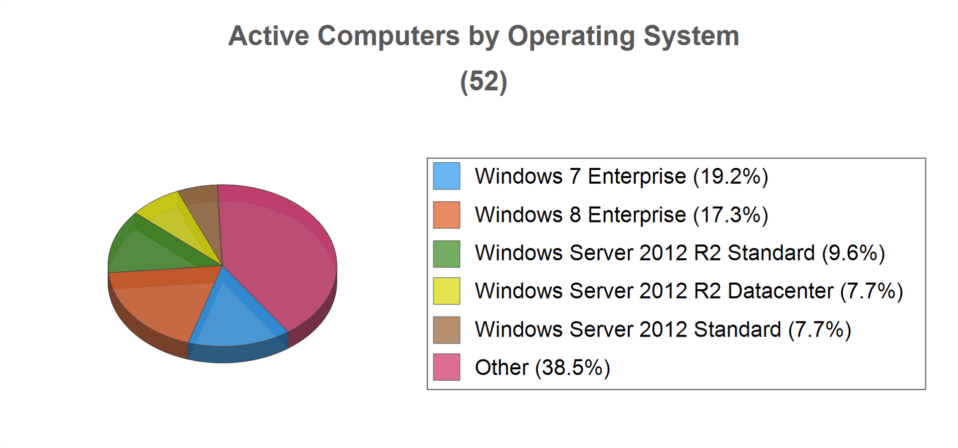
Environment - Overview
Domain
Domain Controllers | 4
Number of Organizational Units | 13
Users
# Enabled | 49
Last Login within 30 days | 24
Last Login older than 30 days | 25
# Disabled | 28
Last Login within 30 days | 0
Last Login older than 30 days | 28
Security Group
Groups with Users | 31
# Total Groups | 60
Computers in Domain
Total Computers | 153
Last Login within 30 days | 52
Last Login older than 30 days | 101
Notes:
Click to add notes

Slide 4
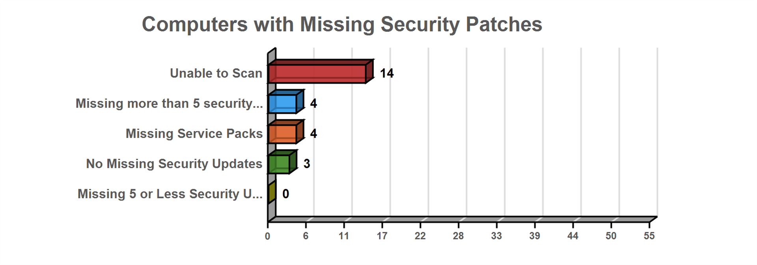
Environment - Patching
Notes:
Click to add notes

Slide 5
Risk and Issue Score
Risk Score
Issue Score
Notes:
Click to add notes

Slide 6
Issue Review
Potential Password Strength Risks (100 pts)
Issue: Local account passwords on 2 accounts were found to be potentially weak. Inadequate or weak passwords on local accounts can allow a hacker to compromise the system. It can also lead to the spread of malicious software that can cause business and productivity affecting issues.
Recommendation: We recommend placing adequate password strength requirements in place and remediate the immediate password issues on the identified systems.
PIT\PSIMPSON1\pablo
PIT\JIM-WIN7\jim
Notes:
This is an issue slide. One is created for each issue found. Remove issues that you do not wish to highlight

Slide 7
Issue Review
Unsupported Microsoft Office Version (97 pts)
Issue: Computers found using a version of Microsoft Office that is no longer supported. Unsupported software no longer receives vital security patches and present an inherent risk.
Recommendation: Upgrade Microsoft Office versions that are no longer supported.
JIM-WIN7 / Microsoft Office Professional Plus 2010
JIM-WIN8 / Microsoft Office Office Subscription (English) 2010
JIM-WIN8 / Microsoft Office Professional Plus 2010
JIM-WIN8 / Microsoft Office Professional Plus Subscription 2010
MARKETING-1 / Microsoft Office Office Subscription (English) 2010
MARKETING-1 / Microsoft Office Professional Plus 2010
MARKETING-1 / Microsoft Office Professional Plus Subscription 2010
MmayhemON1 / Microsoft Office Live Meeting 2007
MmayhemON1 / Microsoft Office Professional 2007
PSIMPSON1 / Microsoft Office Professional Plus 2010
PSIMPSON1 / Microsoft Office Visio 2010
PSIMPSON-WIN764 / Microsoft Office Professional Plus 2010
REX / Microsoft Office Professional Plus 2010
SE-DAVIS / Microsoft Office Professional Plus 2010
slowe-win7.corp.MyCo.com / Microsoft Office Office Subscription (English) 2010
First 15 of 23 displayed. See Management Plan for full list.
Notes:
This is an issue slide. One is created for each issue found. Remove issues that you do not wish to highlight

Slide 8
Issue Review
Unsupported Operating Systems (97 pts)
Issue: found using an operating system that is no longer supported. Unsupported operating systems no longer receive vital security patches and present an inherent risk.
Recommendation: Upgrade or replace computers with operating systems that are no longer supported.
MYCOPATCH / 10.0.7.55 / Windows 2000 Server
ISA1 / 10.0.1.6 / Windows Server 2003 R2
REMOTE / 10.0.7.68 / Windows 2000 Server
JAGA / 10.0.7.67 / Windows Server 2003
USER-PC23 / 10.0.7.96 / Windows 7 Enterprise
STORAGE01 / 10.0.1.69 / Windows Server 2008 R2 Enterprise
PABUILD / 10.0.7.60 / Windows Server 2003
THRASH2 / 10.0.1.33 / Windows 2000 Server
DHAROLD-PC / 10.0.7.1 / Windows 7 Enterprise
EHAMMOND-WIN7 / / Windows 7 Enterprise
REX / 10.0.7.47 / Windows 7 Enterprise
BKRICKEY-WIN7 / 10.0.7.74 / Windows 7 Enterprise
MSUMMER-LT / 10.0.7.34 / Windows 7 Enterprise
MYCO-ATL-CORE / 10.0.1.17 / Windows Server 2003 R2
DEVWIKI / 10.0.7.62 / Windows Server 2003
First 15 of 25 displayed. See Management Plan for full list.
Notes:
This is an issue slide. One is created for each issue found. Remove issues that you do not wish to highlight

Slide 9
Issue Review
Anti-spyware not installed (94 pts)
Issue: Anti-spyware software was not detected on some computers. Without adequate anti-virus and anti-spyware protection on all workstations and servers, the risk of acquiring malicious software is significant.
Recommendation: To prevent both security and productivity issues, we strongly recommend assuring anti-spyware is deployed to all possible endpoints.
Computer: JAGA IP Address: 10.0.7.67
Computer: PABUILD IP Address: 10.0.7.60
Computer: MYCO-ATL-CORE IP Address: 10.0.1.17
Computer: DEVWIKI IP Address: 10.0.7.62
Computer: UTIL12 IP Address: 10.0.1.15
Computer: HV05 IP Address: 10.0.7.61
Computer: HV02 IP Address: 10.0.7.27
Computer: HV01 IP Address: 10.0.1.111
Computer: HV04 IP Address: 10.0.1.141
Computer: MYCOROOTAUTH IP Address: 10.0.1.44
Computer: HV03 IP Address: 10.0.1.139
Computer: FILE2012-1 IP Address: 10.0.1.41
Computer: DEVTFS IP Address: 10.0.7.69
Computer: SQL2012-01 IP Address: 10.0.1.61
Computer: DEV_2012-CORE IP Address: 10.0.7.53
First 15 of 21 displayed. See Management Plan for full list.
Notes:
This is an issue slide. One is created for each issue found. Remove issues that you do not wish to highlight

Slide 10
Issue Review
Anti-virus not installed (94 pts)
Issue: Anti-virus software was not detected on some computers. Without adequate anti-virus and anti-spyware protection on all workstations and servers, the risk of acquiring malicious software is significant.
Recommendation: To prevent both security and productivity issues, we strongly recommend assuring anti-virus is deployed to all possible endpoints.
Computer: JAGA IP Address: 10.0.7.67
Computer: PABUILD IP Address: 10.0.7.60
Computer: MYCO-ATL-CORE IP Address: 10.0.1.17
Computer: DEVWIKI IP Address: 10.0.7.62
Computer: TANDEM IP Address: 10.0.7.28
Computer: UTIL12 IP Address: 10.0.1.15
Computer: slowe-win7.corp.MyCo.com IP Address: 10.0.7.19
Computer: HV05 IP Address: 10.0.7.61
Computer: JIM-WIN7 IP Address: 10.0.7.63
Computer: MmayhemON1 IP Address: 10.0.7.31
Computer: HV02 IP Address: 10.0.7.27
Computer: HV01 IP Address: 10.0.1.111
Computer: MARKETING-1 IP Address: 10.0.7.29
Computer: HV04 IP Address: 10.0.1.141
Computer: MYCOROOTAUTH IP Address: 10.0.1.44
First 15 of 28 displayed. See Management Plan for full list.
Notes:
This is an issue slide. One is created for each issue found. Remove issues that you do not wish to highlight

Slide 11
Issue Review
Anti-spyware not turned on (92 pts)
Issue: We were unable to determine if an anti-spyware software is enabled and running on some computers.
Recommendation: Determine if anti-spyware is enabled properly.
Computer: MmayhemON1 IP Address: 10.0.7.31 Security Center: Windows Defender
Computer: PSIMPSON-WIN764 IP Address: 10.0.7.18 Security Center: Windows Defender
Computer: SE-DAVIS IP Address: 10.0.7.20 Security Center: Windows Defender
Notes:
This is an issue slide. One is created for each issue found. Remove issues that you do not wish to highlight

Slide 12
Issue Review
Anti-virus not turned on (92 pts)
Issue: We were unable to determine if an anti-virus software is enabled and running on some computers.
Recommendation: Determine if anti-virus is enabled properly.
Computer: PSIMPSON-WIN764 IP Address: 10.0.7.18 Security Center: Windows Defender
Notes:
This is an issue slide. One is created for each issue found. Remove issues that you do not wish to highlight

Slide 13
Issue Review
LOTS of Security patches missing on computers (90 pts)
Issue: Security patches are missing on computers. Maintaining proper security patch levels helps prevent unauthorized access and the spread of malicious software. Lots is defined as missing 3 or more patches.
Recommendation: Address patching on computers missing 4+ security patches.
HV02 / 10.0.7.27 / Windows Server 2012 R2 Standard
MmayhemON1 / 10.0.7.31 / Windows Vista (TM) Business
REX / 10.0.7.47 / Windows 7 Enterprise
DEVWIKI / 10.0.7.62 / Windows Server 2003
Notes:
This is an issue slide. One is created for each issue found. Remove issues that you do not wish to highlight

Slide 14
Issue Review
Anti-virus not up to date (90 pts)
Issue: Up to date anti-virus definitions are required to properly prevent the spread of malicious software. Some anti-virus definitions were found to not be up to date.
Recommendation: Ensure anti-virus definitions are up to date on specified computers.
Computer: SLOWE-WIN8 IP Address: 10.0.6.0 Security Center: GFI Software VIPRE
Computer: BKRICKEY-WIN7 IP Address: 10.0.7.74 Security Center: GFI Software VIPRE
Notes:
This is an issue slide. One is created for each issue found. Remove issues that you do not wish to highlight

Slide 15
Issue Review
Anti-spyware not up to date (90 pts)
Issue: Up to date anti-spyware definitions are required to properly prevent the spread of malicious software. Some anti-spyware definitions were found to not be up to date.
Recommendation: Ensure anti-spyware definitions are up to date on specified computers.
Computer: SLOWE-WIN8 IP Address: 10.0.6.0 Security Center: GFI Software VIPRE
Computer: BKRICKEY-WIN7 IP Address: 10.0.7.74 Security Center: GFI Software VIPRE
Computer: TANDEM IP Address: 10.0.7.28 Security Center: Windows Defender
Computer: JIM-WIN7 IP Address: 10.0.7.63 Security Center: Windows Defender
Notes:
This is an issue slide. One is created for each issue found. Remove issues that you do not wish to highlight

Slide 16
Issue Review
Potential Disk Space Issue (68 pts)
Issue: 2 computers were Computers were found with significantly low free disk space.
Recommendation: Free or add additional disk space for the specified drives.
JAGA - C: : 0 GB free
REX - F: : 0.07 GB free
Notes:
This is an issue slide. One is created for each issue found. Remove issues that you do not wish to highlight

Slide 17
Issue Review
User password set to never expire (30 pts)
Issue: User accounts with passwords set to never expire present a risk of use by unauthorized users. They are more easily compromised than passwords that are routinely changed.
Recommendation: Investigate all accounts with passwords set to never expire and configure them to expire regularly.
CORP.MYCO.COM\Administrator / Administrator
CORP.MYCO.COM\BKRICKEY / Beth krickey
CORP.MYCO.COM\fthomas / Fred thomas
CORP.MYCO.COM\JDAVIS / James DAVIS
CORP.MYCO.COM\kjacobs / Kevin jacobs
CORP.MYCO.COM\kmayhem / Kevin mayhem
CORP.MYCO.COM\mDAVIS / michal DAVIS
CORP.MYCO.COM\mELKINS / Michael ELKINS
CORP.MYCO.COM\mmayhemON / Michael mayhemON
CORP.MYCO.COM\mparish / marcusus parish
CORP.MYCO.COM\mSUMMER / Mark SUMMER
CORP.MYCO.COM\Pkrickey / Paul krickey
CORP.MYCO.COM\pSIMPSON / Pablo SIMPSON
CORP.MYCO.COM\rjohnson / Ray Johnson
CORP.MYCO.COM\rphillis / Rita phillis
First 15 of 35 displayed. See Management Plan for full list.
Notes:
This is an issue slide. One is created for each issue found. Remove issues that you do not wish to highlight

Slide 18
Issue Review
Operating System in Extended Support (20 pts)
Issue: found using an operating system that is in extended supported. Extended support is a warning period before an operating system is no longer supported by the manufacturer and will no longer receive support or patches.
Recommendation: Upgrade computers that have operating systems in Extended Support before end of life.
PKWin8 / 10.0.7.54 / Windows 8.1 Pro
UTIL12 / 10.0.1.15 / Windows Server 2012 R2 Standard
HV05 / 10.0.7.61 / Windows Server 2012 R2 Standard
HV02 / 10.0.7.27 / Windows Server 2012 R2 Standard
PSIMPSON-WIN764 / 10.0.7.18 / Windows 8.1 Enterprise
JIM-WIN8 / 10.0.7.44 / Windows 8.1 Enterprise
HV01 / 10.0.1.111 / Windows Server 2012 R2 Standard
HV04 / 10.0.1.141,10.0.1.149,10.0.1.142,10.0.1.145 / Windows Server 2012 Standard
MYCOROOTAUTH / 10.0.1.44 / Windows Server 2012 R2 Datacenter
HV03 / 10.0.1.139,10.0.1.131,10.0.1.135,10.0.1.132 / Windows Server 2012 Standard
FILE2012-1 / 10.0.1.41 / Windows Server 2012 R2 Standard
DEVTFS / 10.0.7.69 / Windows Server 2012 Standard
SQL2012-01 / 10.0.1.61 / Windows Server 2012 R2 Datacenter
MmayhemON-HP / 10.0.7.93 / Windows 8.1 Enterprise
DC01 / fe80::c479:f74:16d0:1a95%16,172.20.1.3,10.0.1.3 / Windows Server 2012 Standard
First 15 of 18 displayed. See Management Plan for full list.
Notes:
This is an issue slide. One is created for each issue found. Remove issues that you do not wish to highlight

Slide 19
Issue Review
Inactive Computers (15 pts)
Issue: found as having not checked in during the past 30 days.
Recommendation: Investigate the list of inactive computers and determine if they should be removed from Active Directory, rejoined to the network, or powered on.
MEGATRON / / Windows Server 2003
MYCONMS-BDF / / Windows Server 2003
VM-WIN7-2 / / Windows 7 Enterprise
TESTSERVER1 / / Windows Server 2008 R2 Standard
SHAREPOINT1 / / Windows Server 2003
pkrickey1 / / Windows 7 Professional
STARSCREAM / / Windows Server 2003
VM-WIN2003 / / Windows Server 2003
VM2-2003 / / Windows Server 2003
MYCO-ATL-HPV01 / / Windows Server 2008 Enterprise
WIN2008 / / Windows Server 2008 Standard
VM1-WIN2003 / / Windows Server 2003
Dwilliams2 / / Windows XP Professional
PKWIN7ENT / 10.0.7.60 / Windows 7 Enterprise
VM-WIN7 / 10.0.7.68 / Windows 7 Enterprise
First 15 of 101 displayed. See Management Plan for full list.
Notes:
This is an issue slide. One is created for each issue found. Remove issues that you do not wish to highlight

Slide 20
Issue Review
User has not logged in in 30 days (13 pts)
Issue: Users that have not logged in in 30 days could be from a former employee or vendor and should be disabled or removed.
Recommendation: Disable or remove user accounts for users that have not logged in in 30 days.
ASPNET / ASPNET
bvinings / Bob vinings
bgelding / Beth gelding
bminor / Brad Minor
DEV$ / DEV$
HJoel / Hank\ Joel
jcosten / Joe Costen
kglass / K glass
kmayhem1 / k mayhem1
mWEST / Madeleine WEST
NetScanner / Net Scanner - MyCo
netvendor / netvendor
hr / internal IT HR
partners / internal IT Managed Services Partners
info / internal IT PR
First 15 of 23 displayed. See Management Plan for full list.
Notes:
This is an issue slide. One is created for each issue found. Remove issues that you do not wish to highlight

Slide 21
Issue Review
Insecure Listening Ports (10 pts)
Issue: were found to be using potentially insecure protocols.
Recommendation: There may be a legitimate business need, but these risks should be assessed individually. Certain protocols are inherently insecure since they typically lack encryption. Inside the network, their use should be minimized as much as possible to prevent the spread of malicious software. Of course, there can be reasons these services are needed and other means to protect systems which listen on those ports. We recommend reviewing the programs listening on the network to ensure their necessity and security.
RANCOR.Corp.MyCo.com (10.0.7.57) - Listening ports: 21
MYCO30dev.Corp.MyCo.com (10.0.7.65) - Listening ports: 21
ISA1.Corp.MyCo.com (10.0.7.43) - Listening ports: 23
pitmacmini.corp.MyCo.com (10.0.7.45) - Listening ports: 5900
Unknown Device Name (10.0.7.64) - Listening ports: 21
hp2100-ops.corp.MyCo.com (10.0.7.76) - Listening ports: 21, 23
Unknown Device Name (10.0.7.70) - Listening ports: 5900
Notes:
This is an issue slide. One is created for each issue found. Remove issues that you do not wish to highlight

Slide 22
Issue Review
Un-populated Organization Units (10 pts)
Issue: Empty Organizational Units (OU) were found in Active Directory. They may not be needed and should be removed to prevent misconfiguration.
Recommendation: Remove or populate empty Organizational Units.
test hash / OU=test hash,OU=PIT_Users,DC=Corp,DC=MyCo,DC=com
Notes:
This is an issue slide. One is created for each issue found. Remove issues that you do not wish to highlight

Slide 23
Next Steps
Agree on List of Issues to Resolve
Present Project Estimates and Costs
Establish Timelines
Set Milestones
Get Signoff to Begin Work
Notes:
The Next Steps lists all recommendations for all issues. If you remove an issue, you should remove the corresponding recommendation.

